Slide 1
Google Mobility Data Analysis Canada and Australia

Slide 2
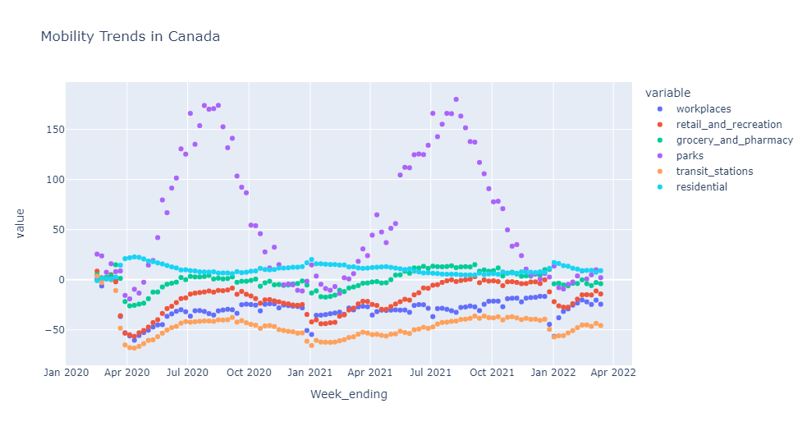
Mobility in Canada
The report highlights the trends in mobility in Canada across a variety of categories.
The usage of parks has increased substantially during the pandemic, as shown in the graph.
When compared to pre-pandemic levels, residential mobility has increased marginally.
The trend in grocery and pharmacy mobility is close to the baseline level.
Mobility has plummeted in retail and recreation, workplaces, and transit stations.

Slide 3
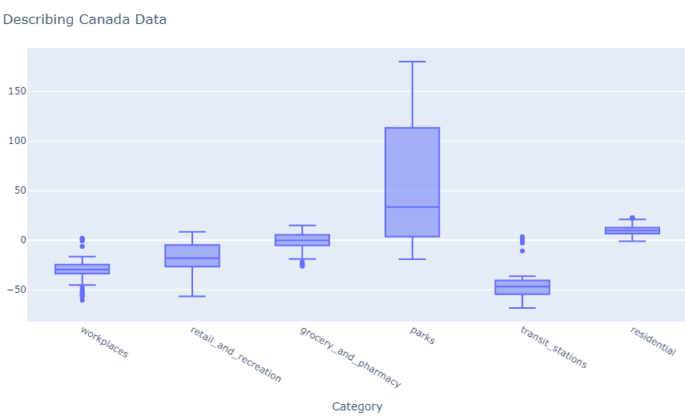
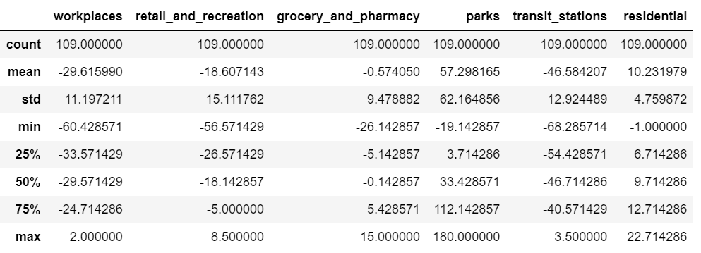
Understanding Canada Mobility Data

Slide 4
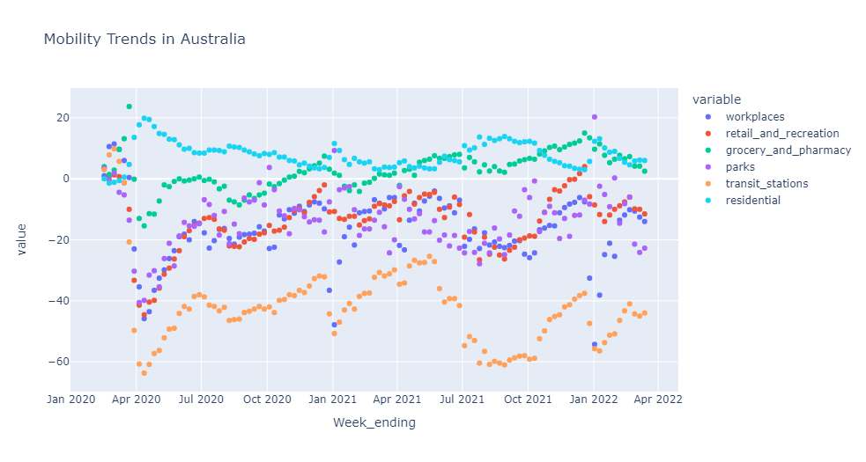
Mobility in Australia
The graph depicts mobility trends in different areas of Australia.
During the pandemic, mobility in residential areas has increased considerably.
Mobility at grocery stores and pharmacies remained close to baseline in the initial months of 2020, before increasing toward the end of 2021.
Mobility in Transit stations decreased dramatically during the entirety of pandemic.
Rise and fall in other places have followed the trend of different phases of lockdown nonetheless remains lower than early 2020.

Slide 5
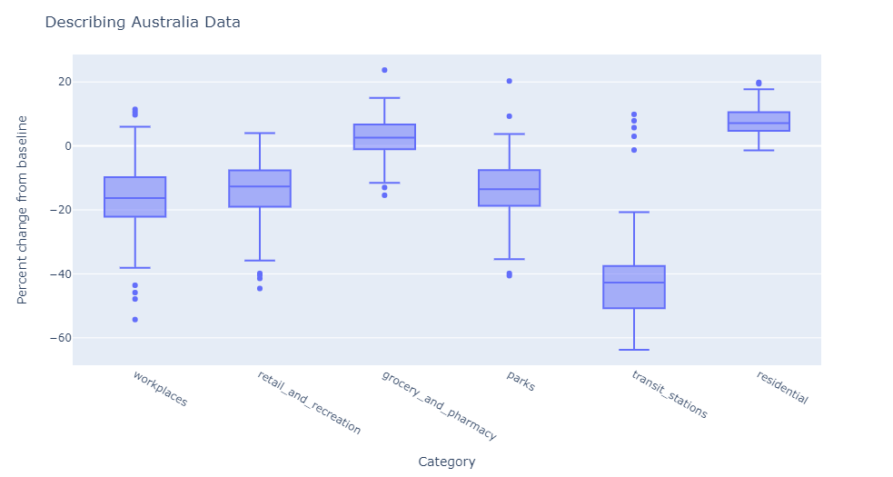
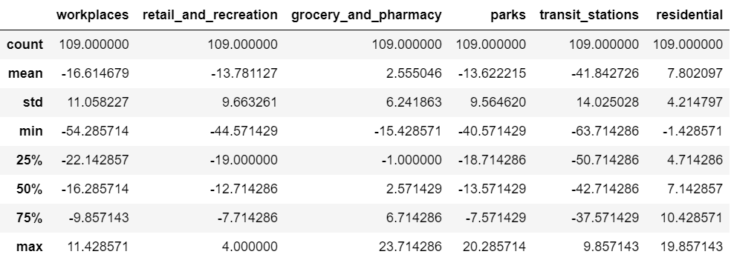
Understanding Australia Mobility Data

Slide 6
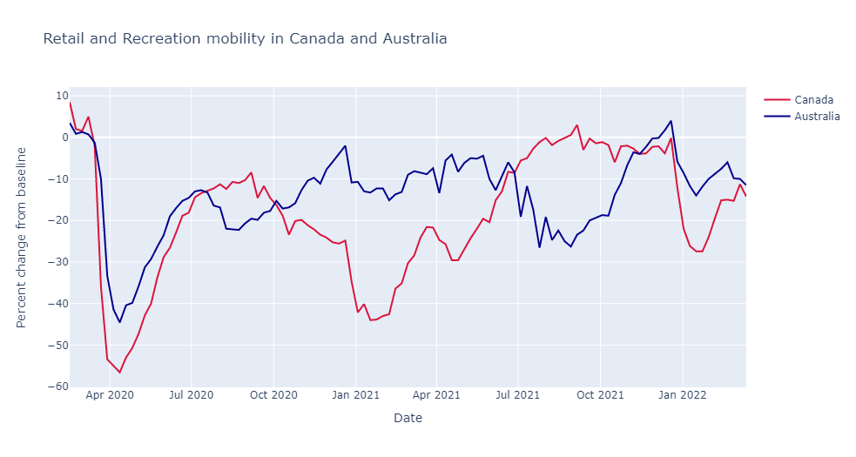
Retail and Recreation
This shows the trends in mobility in the retail and recreation category
Since the onset of pandemic in March and April 2020, Canada and Australia show limited mobility in this category.
However, the mobility trend in the countries vary significantly later with no considerable relation between them.
Retail and recreation visits are approaching levels last seen before the pandemic in Australia in October 2021 and Canada in late 2021.

Slide 7
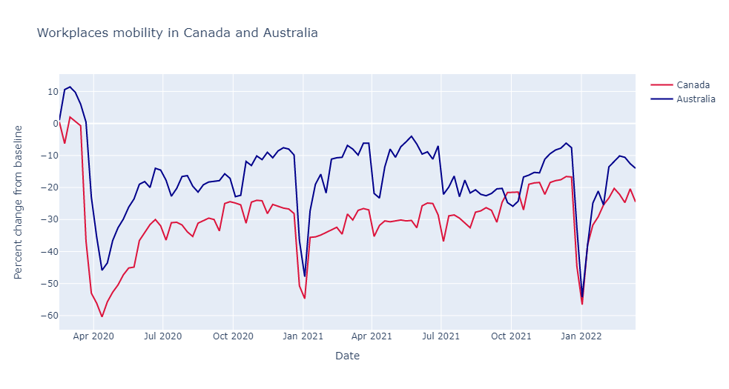
Workplaces
The graph describes the mobility at workplaces for the years 2020-2022 in Canada and Australia.
The sharp drop in mobility is in accordance with the trend of various lockdowns in the respective countries.
In contrast to mobility in other areas, which shows a variable pattern, mobility at workplaces almost remains synonymous with both countries.

Slide 8
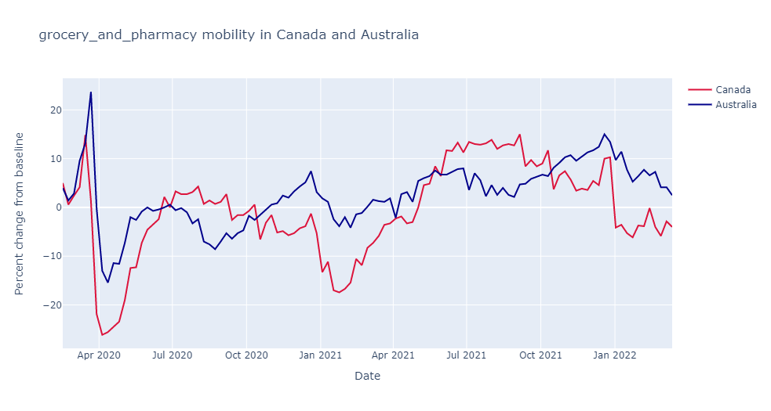
Grocery and Pharmacy
The graph shows the mobility levels in Canada and Australia.
The initial rise in mobility in the beginning of the pandemic in early April 2020 shows that people are visiting pharmacies and grocery stores more frequently than before due to the uncertainty of the pandemic.
In the case of Australia, there is a drop later in the mobility, although it has progressively returned to baseline in late 2021.
Canada shows a depreciated mobility at pharmacies and grocery stores in early 2021 but seems to be gradually increasing by the end of 2021.

Slide 9
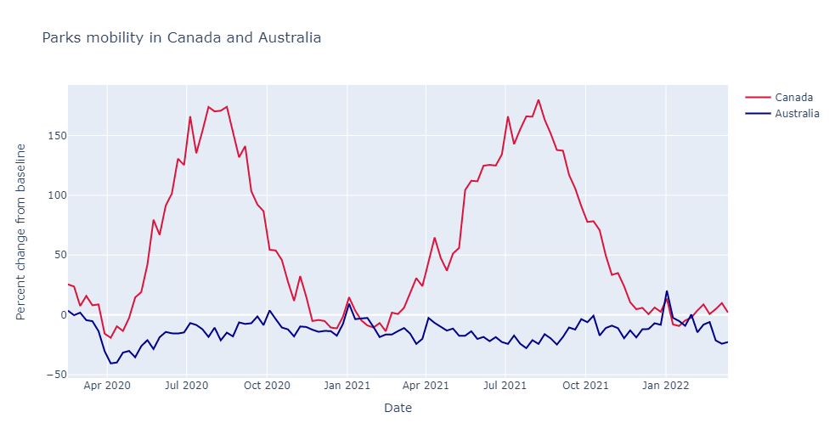
Parks
Canada shows a dramatic increase in the number of visitors to parks in this graph.
It also shows a gradual increase and decrease in mobility that appears to follow the pattern of various lockdowns in the country.
Australia appears to have a steady mobility pattern, with its share of highs and lows, but it is still close to the baseline.

Slide 10
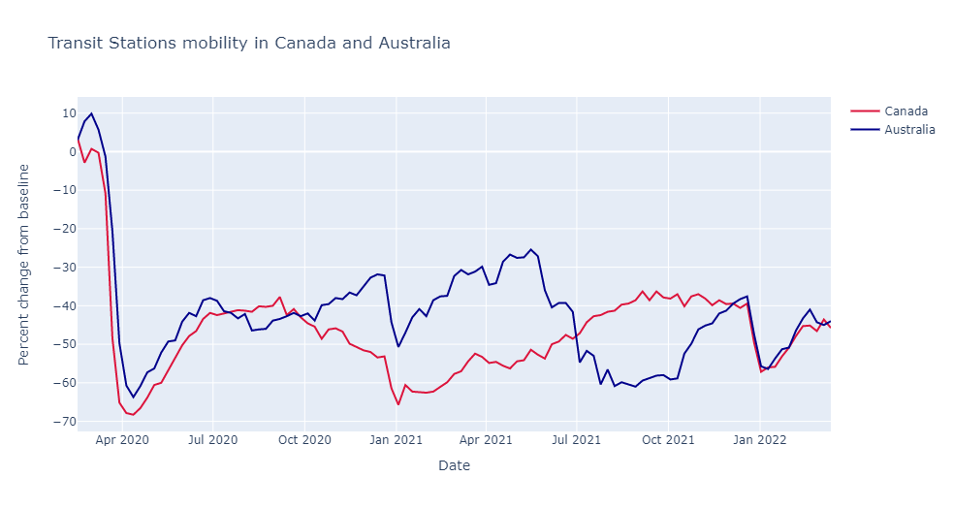
Transit Stations
Throughout the time period of 2020-2022, the mobility trend at the transit stations is the only place where the level is extremely lower than the baseline.
Limited mobility is a typical trend observed in both countries at transit stations.
The current rate of mobility is still nowhere near that of before the pandemic.
The most likely explanation is that mobility at transit stations is directly associated with mobility at other places.

Slide 11
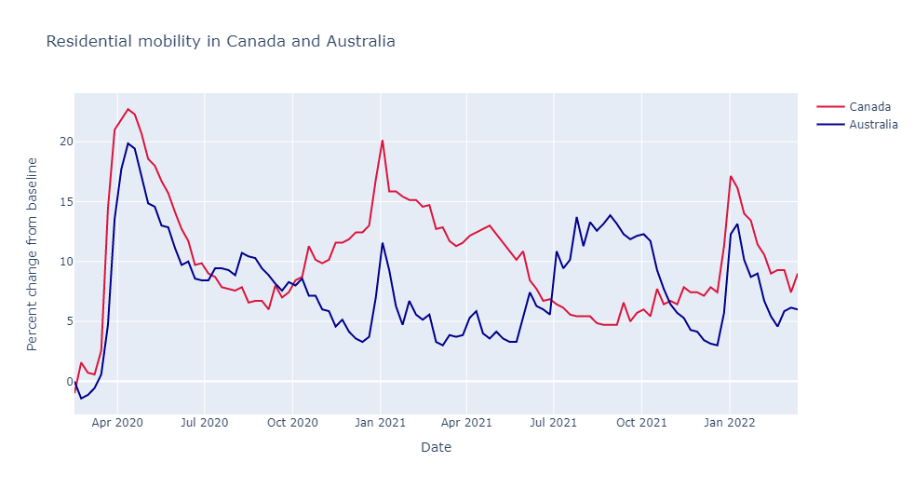
Residential
Since the pandemic began in early 2020, residential mobility has increased all around the world and the same can be seen in the graph for Canada and Australia.
Initially, the mobility at residential places climbed by 20%, but the rise has now reduced to around 10%.

Slide 12
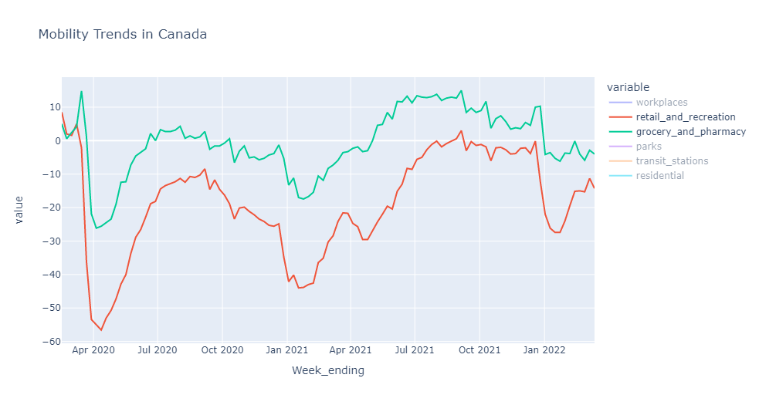
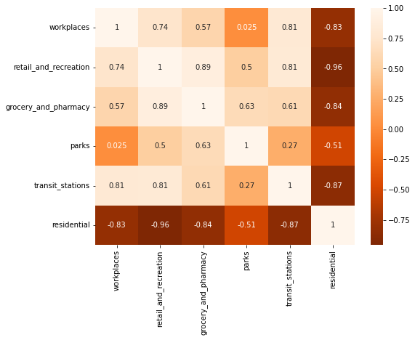
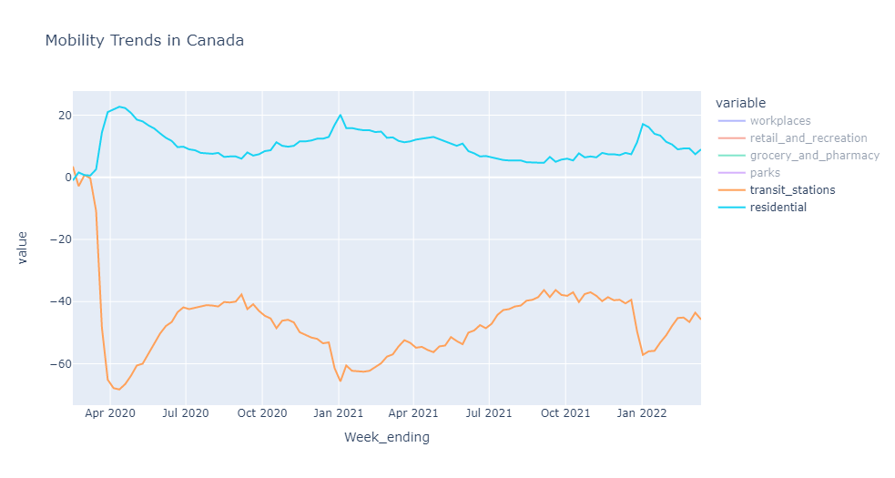
Correlation between categories in Canada
Positively correlated
Negatively correlated

Slide 13
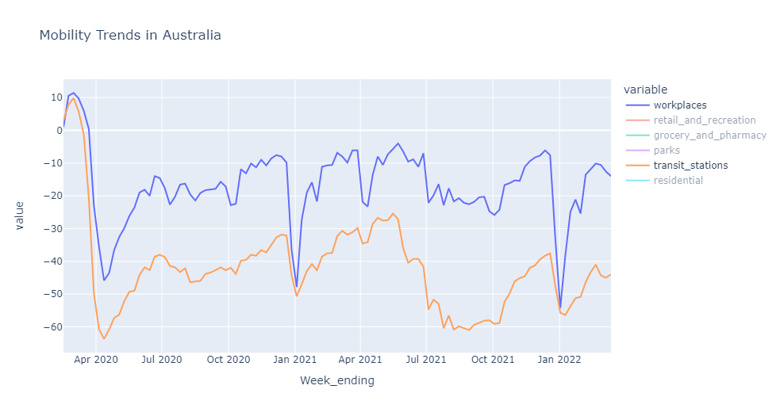
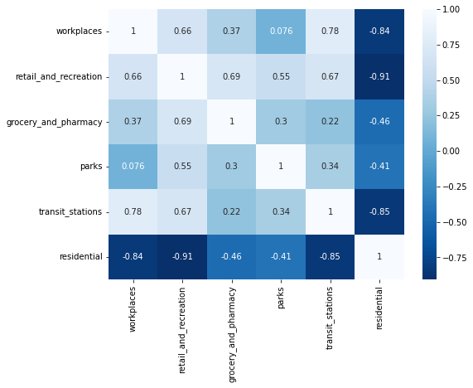
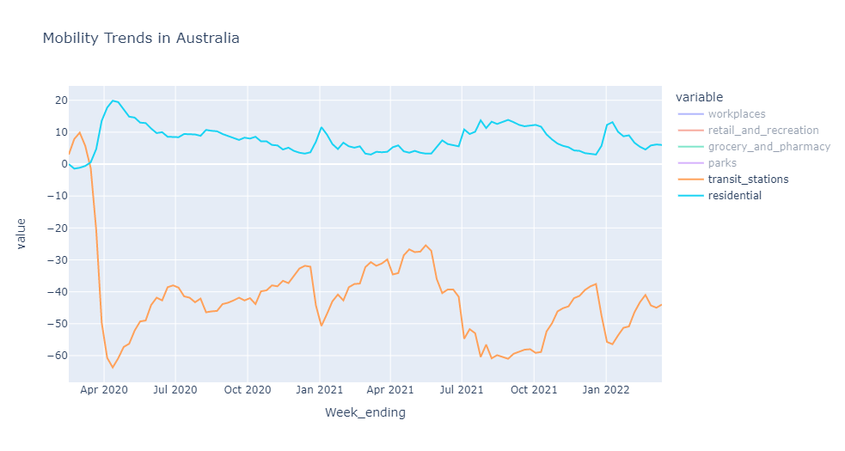
Correlation between categories in Australia
Positively correlated
Negatively correlated

Slide 14
Key Insights
When both countries are studied combined, the initial response to pandemic is similar but it changes during the course.
There is no clear pattern in the trends, except for residential category and workplaces, which appear to have a slightly uniform rate of mobility .
Individually, the category of Parks has the most mobility in Canada, with a remarkable increase in the number of people visiting them.
In Australia, maximum mobility can be observed in the category of Residential places.
In both Canada and Australia, transit places show the least movement.
Retail and Recreation category and grocery and pharmacy category in Canada, show the most positive correlation.
Workplaces and transit stations are highly correlated in Australia.
Least correlated mobility can be seen in retail and recreation category and residential for both Canada and Australia.

Slide 15
Thankyou

